Slide 1
UNIT-6
Sanjay Babu Jaiswal

Slide 2
1.
Introduction to containers
Container architectures
Docker containers
Kubernetes
2.
Amazon Web Services
Google App Engine
Microsoft Azure
Contents
3.
Edge Computing
Fog Computing
IIoT
Green Cloud computing practices
Complexity in Cloud Native systems

Slide 3
Introduction to Containers
A container is a standard unit of software that packages up code and all its dependencies so the application runs quickly and reliably from one computing environment to another.
A Docker container image is a lightweight, standalone, executable package of software that includes everything needed to run an application: code, runtime, system tools, system libraries and settings.
Container images become containers at runtime and in the case of Docker containers - images become containers when they run on Docker Engine.
Notes:
https://www.docker.com/resources/what-container/#:~:text=Container%20images%20become%20containers%20at,same%2C%20regardless%20of%20the%20infrastructure.

Slide 4
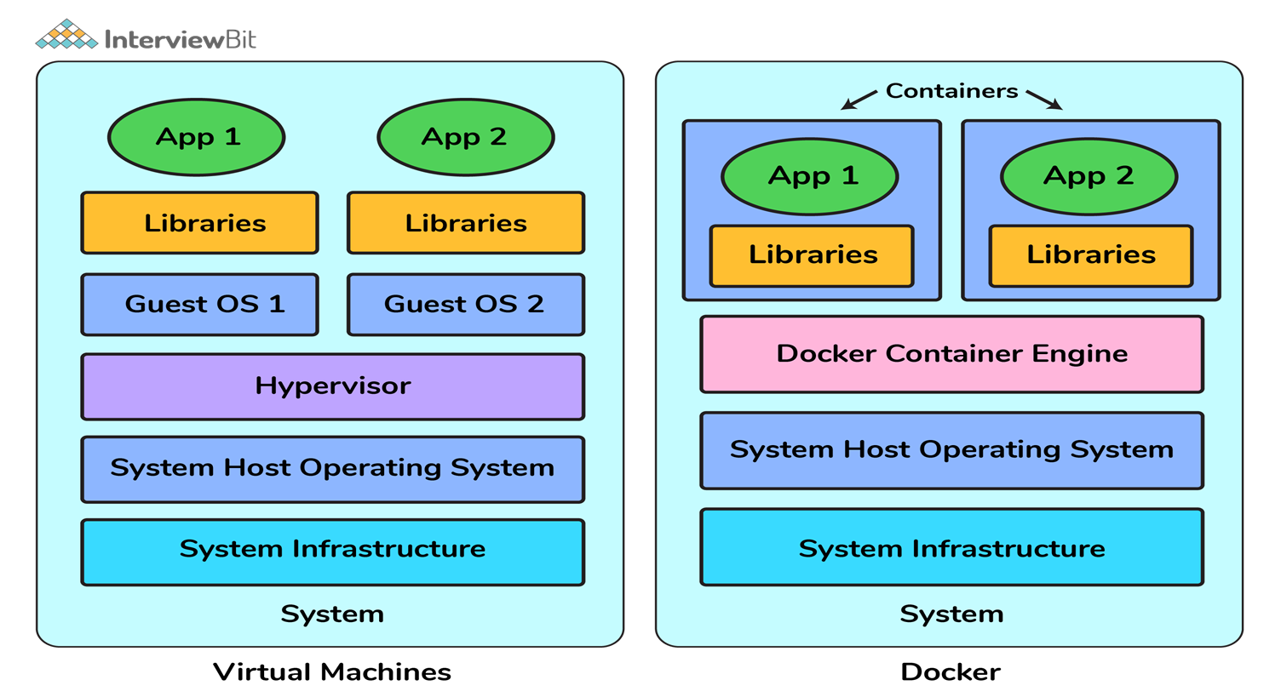
Containers vs. Virtual Machines
When compared to Virtual machines, the Docker platform moves up the abstraction of resources from the hardware level to the Operating System level. This allows for the realization of the various benefits of containers e.g. application portability, infrastructure separation, and self-contained microservices.
Advantages
Resource Efficiency:.
Portability:
Continuous Deployment and Testing:

Slide 5
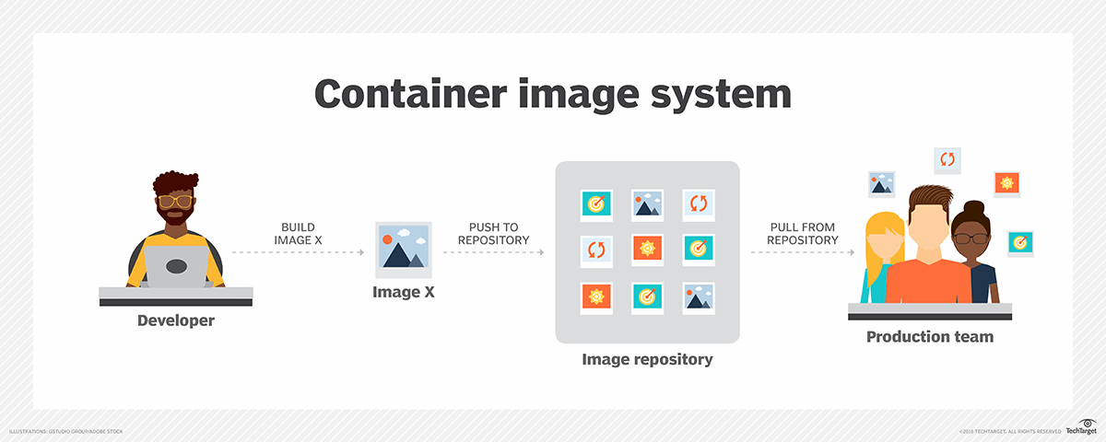

Slide 6
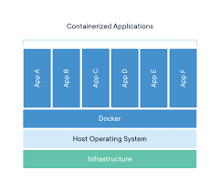
Containers isolate software from its environment and ensure that it works uniformly despite differences for instance between development and staging.
Docker is an open platform for developing, shipping, and running applications. Docker enables you to separate your applications from your infrastructure so you can deliver software quickly.

Slide 7
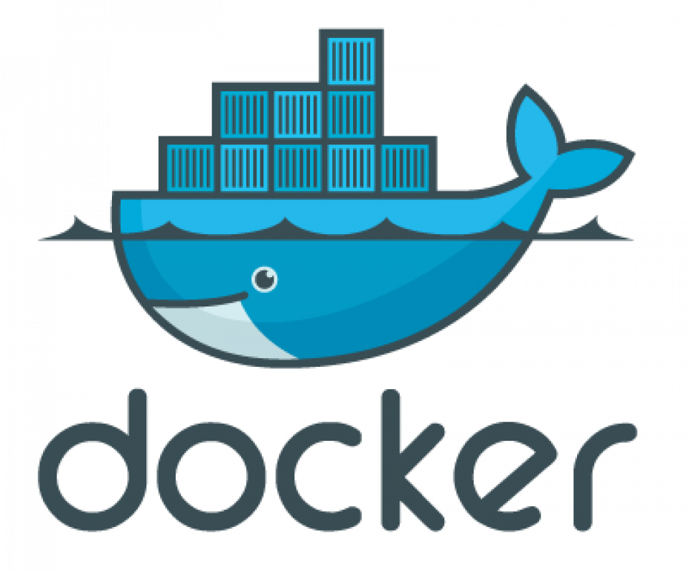
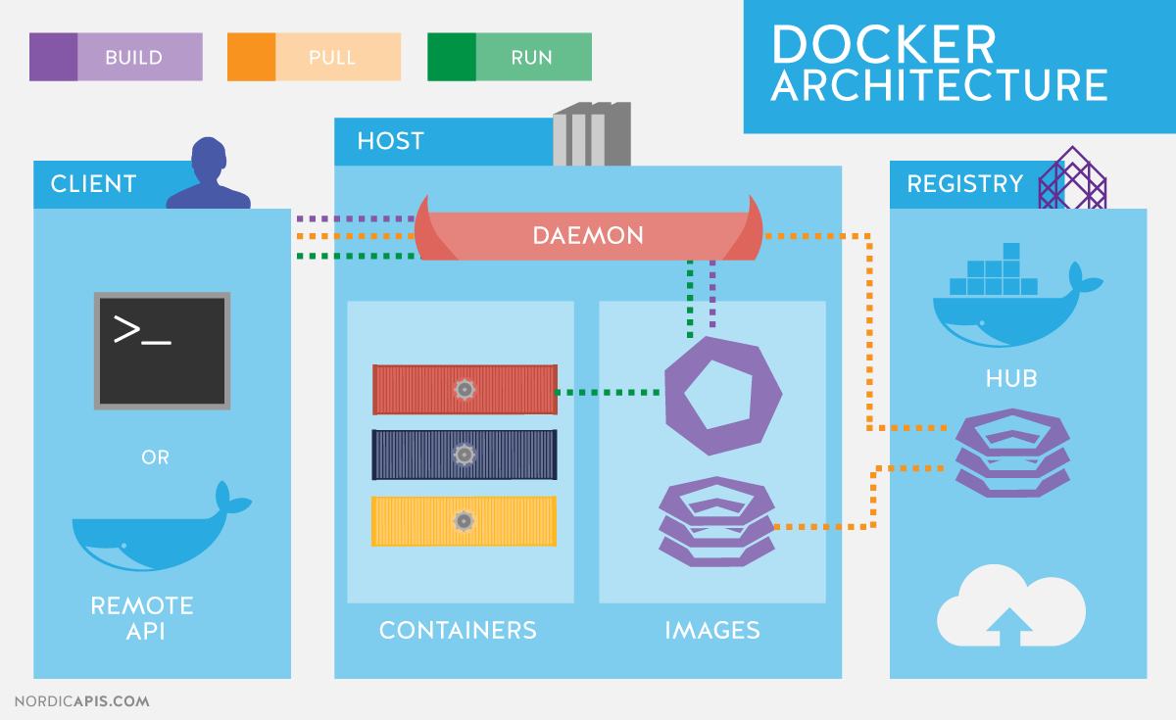
INTRODUCTION TO DOCKERS
Docker uses a client-server architecture. The Docker client talks to the Docker daemon, which does the heavy lifting of building, running, and distributing your Docker containers.

Slide 8
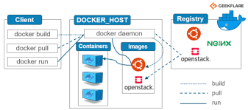

Slide 9
The Docker client and daemon can run on the same system, or you can connect a Docker client to a remote Docker daemon. The Docker client and daemon communicate using a REST API, over UNIX sockets or a network interface.
The Docker daemon
The Docker daemon (dockerd) listens for Docker API requests and manages Docker objects such as images, containers, networks, and volumes.
The Docker client
The Docker client (docker) is the primary way that many Docker users interact with Docker. When we use commands such as docker run, the client sends these commands to dockerd, which carries them out. The docker command uses the Docker API. The Docker client can communicate with more than one daemon.

Slide 10
Docker registries :
A Docker registry stores Docker images. Docker Hub is a public registry that anyone can use, and Docker is configured to look for images on Docker Hub by default. When the docker pull or docker run commands, the required images are pulled from your configured registry.
Docker objects :
When we use Docker, you are creating and using images, containers, networks, volumes, plugins, and other objects. This section is a brief overview of some of those objects.
Images & containers :
An image is a read-only template with instructions for creating a Docker container. Often, an image is based on another image, with some additional customization.
A container is a runnable instance of an image. We can create, start, stop, move, or delete a container using the Docker API or CLI.
We can connect a container to one or more networks, attach storage to it, or even create a new image based on its current state.

Slide 11
Services
Services allow you to scale containers across multiple Docker daemons, which all work together as a swarm with multiple managers and workers. Each member of a swarm is a Docker daemon, and the daemons all communicate using the Docker API.
Docker Engine
Docker Engine is a client-server application with these major components:
A server which is a type of long-running program called a daemon process (the dockerd command).
A REST API which specifies interfaces that programs can use to talk to the daemon and instruct it what to do.
A command line interface (CLI) client (the docker command).

Slide 12
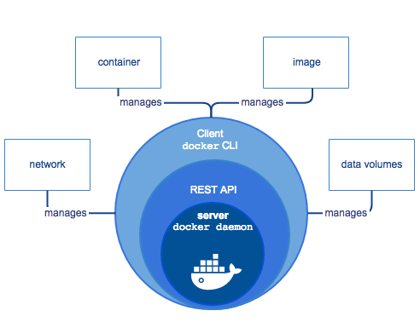
The Docker Engine
Docker Engine allows you to develop, assemble, ship, and run applications using the following components:
Docker Daemon: A persistent background process that manages Docker images, containers, networks, and storage volumes. The Docker daemon constantly listens for Docker API requests and processes them.
Docker Engine REST API: An API used by applications to interact with the Docker daemon; it can be accessed by an HTTP client.
Docker CLI: A command line interface client for interacting with the Docker daemon. It greatly simplifies how you manage container instances and is one of the key reasons why developers love using Docker.

Slide 13
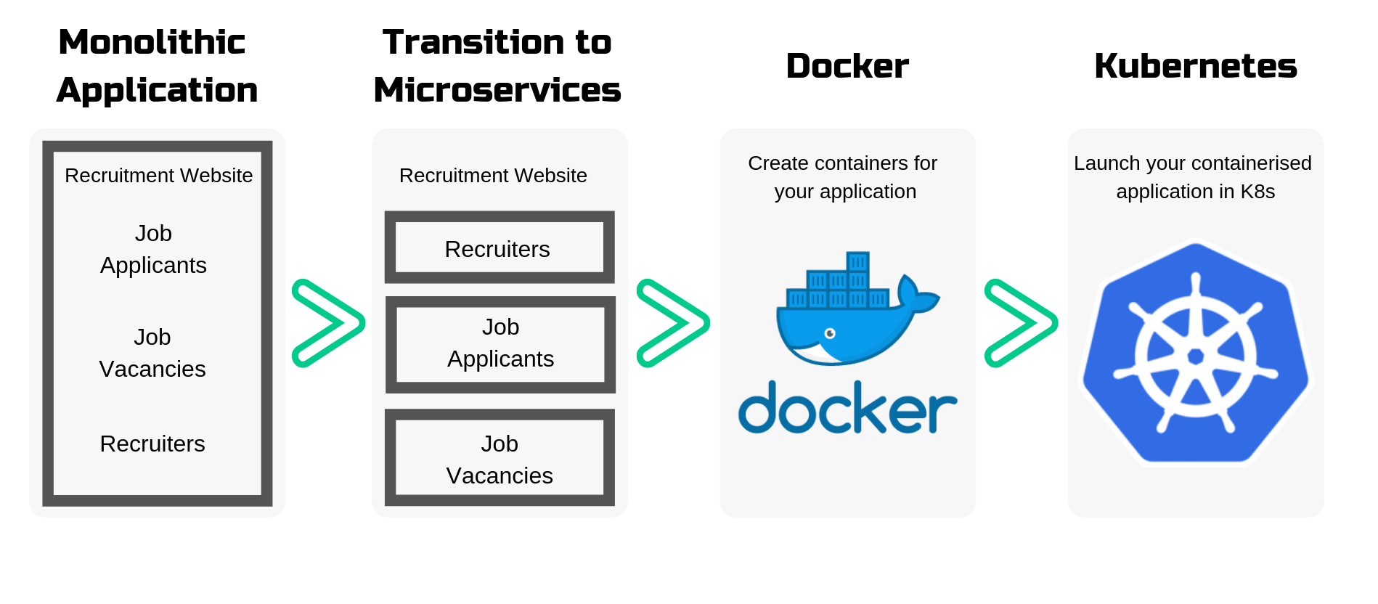

Slide 14
Kubernetes (K8s) is an open-source system for automating deployment, scaling, and management of containerized applications.
Kubernetes

Slide 15
What is Containerization ?
Containerization is operating system-level virtualization or application-level virtualization over multiple network resources so that software applications can run in isolated user spaces called containers in any cloud or non-cloud environment, regardless of type or vendor.
Containerized applications are applications run in isolated packages of code called containers. Containers include all the dependencies that an application might need to run on any host operating system, such as libraries, binaries, configuration files, and frameworks, into a single lightweight executable.
Containers Examples:
All Google applications, like GMail and Google Calendar, are containerized and run on their cloud server.
A gaming or media streaming application that you create using Ridge's Kubernetes service.

Slide 16
Containerization helps package software to serve these goals, enabling applications to be released and updated in an easy and fast way without downtime.
Kubernetes helps you make sure those containerized applications run where and when you want, and helps them find the resources and tools they need to work.
Kubernetes is a production-ready, open source platform designed with Google's accumulated experience in container orchestration, combined with best-of-breed ideas from the community.
A container orchestrator is essentially an administrator in charge of operating a fleet of containerized applications. If a container needs to be restarted or acquire more resources, the orchestrator takes care of it for you.

Slide 17
WHAT IS KUBERNETES USED FOR?
Kubernetes keeps track of your container applications that are deployed into the cloud. It restarts orphaned containers, shuts down containers when they’re not being used, and automatically provisions resources like memory, storage, and CPU when necessary.
How does Kubernetes work with Docker?
Actually, Kubernetes supports several base container engines, and Docker is just one of them. The two technologies work great together, since Docker containers are an efficient way to distribute packaged applications, and Kubernetes is designed to coordinate and schedule those applications.

Slide 18
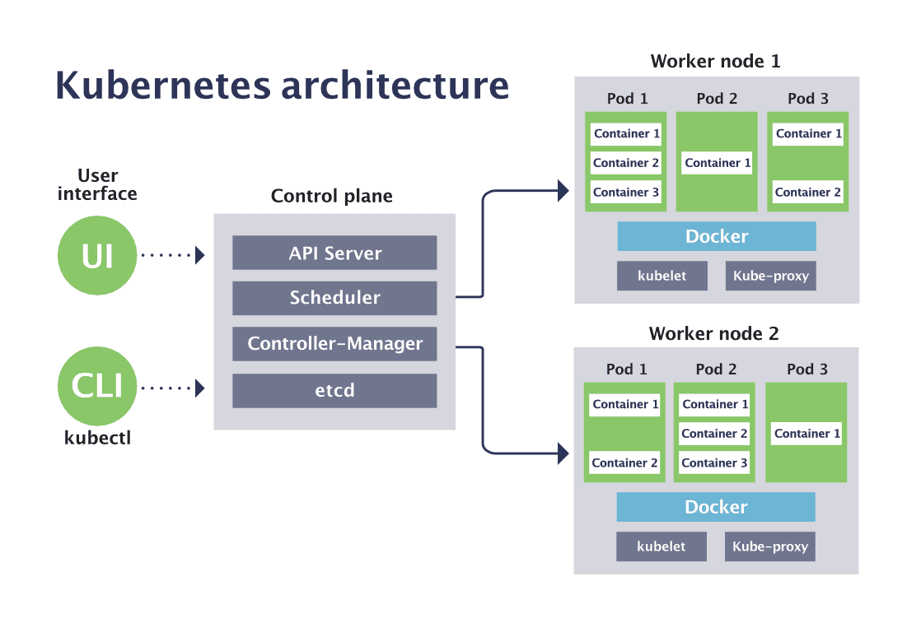

Slide 19
Pods
A Kubernetes pod is a group of containers, and is the smallest unit that Kubernetes administers.
Pods have a single IP address that is applied to every container within the pod. Containers in a pod share the same resources such as memory and storage.
It is common to have a pod with only a single container, when the application or service is a single process that needs to run.
For example, if you were working on an image-processing service that created GIFs, one pod might have several containers working together to resize images.
The primary container might be running the non-blocking microservice application taking in requests, and then one or more auxiliary (side-car) containers running batched background processes or cleaning up data artifacts in the storage volume as part of managing overall application performance.

Slide 20
Kubectl is a command-line interface (CLI) tool for working with a Kubernetes cluster.
Kubectl is the primary means by which a developer can interact with a Kubernetes cluster.
Kubectl is the command line tool to control Kubernetes clusters, from a control host or your workstation.
Kubelet is a technology that applies, creates, updates, and destroys containers on a Kubernetes node.
Kubelet is the agent running on each Kubernetes node to manage the containers locally based on the information provided by the control plane.
Kubelet is the component that runs on all of the machines in your cluster and does things like starting PODs and containers.

Slide 21
ectd is an open-source, distributed key-value store that stores and manages critical information for distributed systems. It's used for shared configuration, service discovery, and scheduler coordination.
etcd is used for Kubernetes, a popular container orchestration platform. It manages the configuration data, state data, and metadata for Kubernetes.
kube-proxy is a Kubernetes agent that runs on each node in a cluster. It monitors changes to Service objects and their endpoints, and translates them into network rules inside the node. These network rules allow network communication to Pods from network sessions inside or outside of the cluster

Slide 22
Deployments
Kubernetes deployments define the scale at which you want to run your application by letting you set the details of how you would like pods replicated on your Kubernetes nodes.
Deployments describe the number of desired identical pod replicas to run and the preferred update strategy used when updating the deployment.
Kubernetes will track pod health, and will remove or add pods as needed to bring your application deployment to the desired state.

Slide 23
Services
A service is an abstraction over the pods, and essentially, the only interface the various application consumers interact with. As pods are replaced, their internal names and IPs might change.
A service exposes a single machine name or IP address mapped to pods whose underlying names and numbers are unreliable.
A service ensures that, to the outside network, everything appears to be unchanged.

Slide 24
Nodes
A Kubernetes node manages and runs pods; it’s the machine (whether virtualized or physical) that performs the given work. Just as pods collect individual containers that operate together, a node collects entire pods that function together. When we are operating at scale, we want to be able to hand work over to a node whose pods are free to take it.
Control plane
The Kubernetes control plane is the main entry point for administrators and users to manage the various nodes. Operations are issued to it either through HTTP calls or connecting to the machine and running command-line scripts. As the name implies, it controls how Kubernetes interacts with your applications.

Slide 25
Cluster
A cluster is all of the above components put together as a single unit.
API server
The API server exposes a REST interface to the Kubernetes cluster. All operations against pods, services, and so forth, are executed programmatically by communicating with the endpoints provided by it.
Scheduler
The scheduler is responsible for assigning work to the various nodes. It keeps watch over the resource capacity and ensures that a worker node’s performance is within an appropriate threshold.

Slide 26
Controller Manager
The controller-manager is responsible for making sure that the shared state of the cluster is operating as expected. More accurately, the controller manager oversees various controllers which respond to events (e.g., if a node goes down).
Kubelet
A Kubelet tracks the state of a pod to ensure that all the containers are running. It provides a heartbeat message every few seconds to the control plane. If a replication controller does not receive that message, the node is marked as unhealthy.
Kube Proxy
The Kube proxy routes traffic coming into a node from the service. It forwards requests for work to the correct containers.

Slide 27
Edge Computing
Edge computing is a distributed IT architecture that moves computing resources from clouds and data centers closer to the originating source. The goal of edge computing is to reduce latency requirements while processing data and saving network costs
A part of a distributed computing topology in which information processing is located close to the edge – where things and people produce or consume that information.”
Edge computing was developed due to the exponential growth of IoT devices, which connect to the internet for either receiving information from the cloud or delivering data back to the cloud. And many IoT devices generate enormous amounts of data during the course of their operations.

Slide 28
Edge computing brings computation and data storage closer to the devices where it’s being gathered, rather than relying on a central location that can be thousands of miles away. In addition, companies can save money by having the processing done locally, reducing the amount of data that needs to be processed in a centralized or cloud-based location.
Edge computing can deliver strong business benefits, including:
-Faster insights
-Improved response times
-Better bandwidth availability
Edge computing can also improve the quality of video streaming services. For example, Netflix uses edge computing to cache content closer to users, which reduces latency and enhances the overall streaming experience.

Slide 29
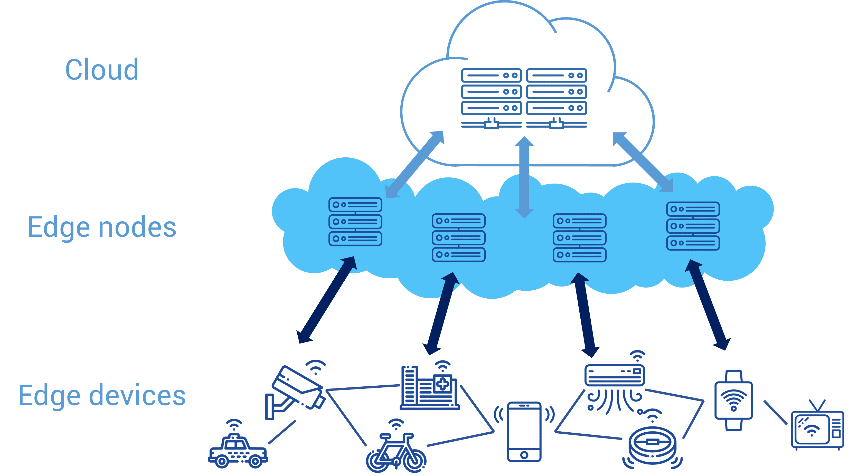
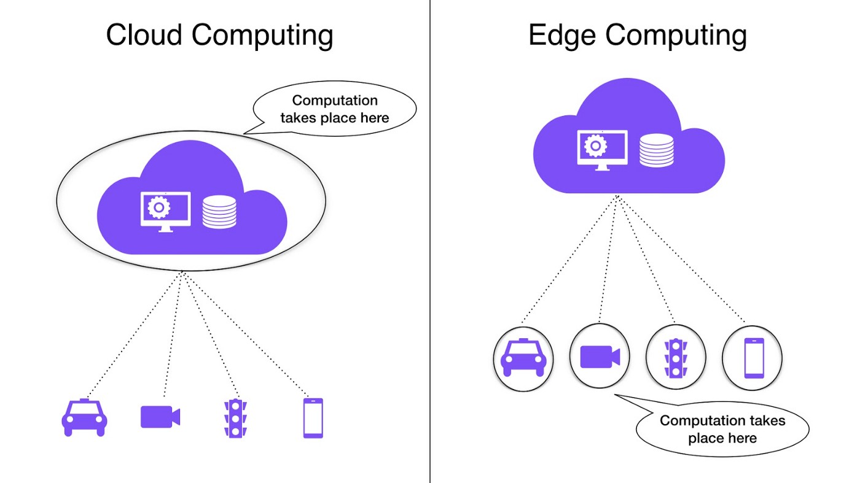

Slide 30
Edge v/s Cloud
Edge and cloud computing have distinct features and most organizations will end up using both. Here are some considerations when looking at where to deploy different workloads.
Cloud Computing | Edge Computing
Non-time-sensitive data processing | Real-time data processing
Reliable internet connection | Remote locations with limited or no internet connectivity
Dynamic workloads | Large datasets that are too costly to send to the cloud
Data in cloud storage | Highly sensitive data and strict data laws

Slide 31
Fog Computing
Fog computing is a decentralized computing structure that places data, storage, and applications between the cloud and devices that produce data. Fog computing is also known as fog networking, fogging, or edge computing.
Fog computing brings computation and data storage closer to the network edge, where many IoT devices are located. This reduces the reliance on the cloud for these resource-intensive tasks, improving performance and reducing latency.
Fog computing is used in industries that require data analytics close to the network edge and use edge computing resources. One major industry that relies heavily on fog computing is healthcare.

Slide 32
Fog Computing
The word "fog" refers to its cloud-like properties, but closer to the "ground",
Fog computing or fog networking, also known as fogging, is an architecture that uses edge devices to carry out a substantial amount of computation, storage, and communication locally and routed over the Internet backbone.
Fog computing can be perceived both in large cloud systems and big data structures, making reference to the growing difficulties in accessing information objectively.
This results in a lack of quality of the obtained content. The effects of fog computing on cloud computing and big data systems may vary.
Fog networking consists of a control plane and a data plane. For example, on the data plane, fog computing enables computing services to reside at the edge of the network as opposed to servers in a data-center.

Slide 33
Specialty | Cloud Computing | Fog Computing
Delay | Cloud computing has higher latency than fog computing | Fog computing has low latency
Capacity | Cloud computing does not provide any reduction in data while sending or converting data. | Fog computing reduces the amount of data sent to cloud computing.
Responsiveness | The response time of the system is low. | The response time of the system is high.
Security | Cloud computing has less security compared to Fog Computing | Fog computing has high Security.
Speed | Access speed is high depending on the VM connectivity. | High even more compared to Cloud Computing.
Data Integration | Multiple data sources can be integrated. | Multiple Data sources and devices can be integrated.
Mobility | In cloud computing, mobility is Limited. | Mobility is supported in fog computing

Slide 34
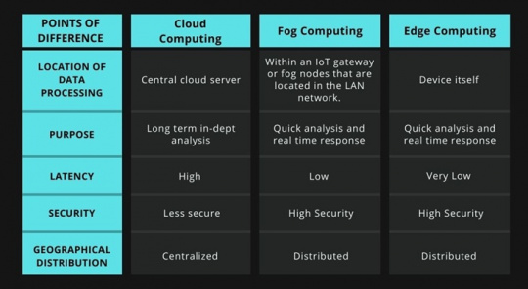

Slide 35
IIoT
The Industrial Internet of Things (IIoT) is a methodology, a practice, an implementation sweeping through businesses and industries worldwide. On a basic level, IIoT is a way of congregating /grouping data that was previously inaccessible and locked within inflexible data streams. This provides all stakeholders with a more complete and comprehensive view of operations.
Imagine smart TVs and watches or security cameras - devices that were historically lacking in internet connection but now have that capability. This is IoT, the Internet of Things. IIoT is used to refer to industrial equipment and plant assets that are now integrated.
Developments in technology are participle in the age of Industry 4.0, where real-time data is captured and made available within integrated digital ecosystems. Similarly, software is now increasingly platform independent , this means that plant floor information won't be originating from a single platform, but there will be a multitude of systems that needs to feed into a companies digital nervous system.

Slide 36
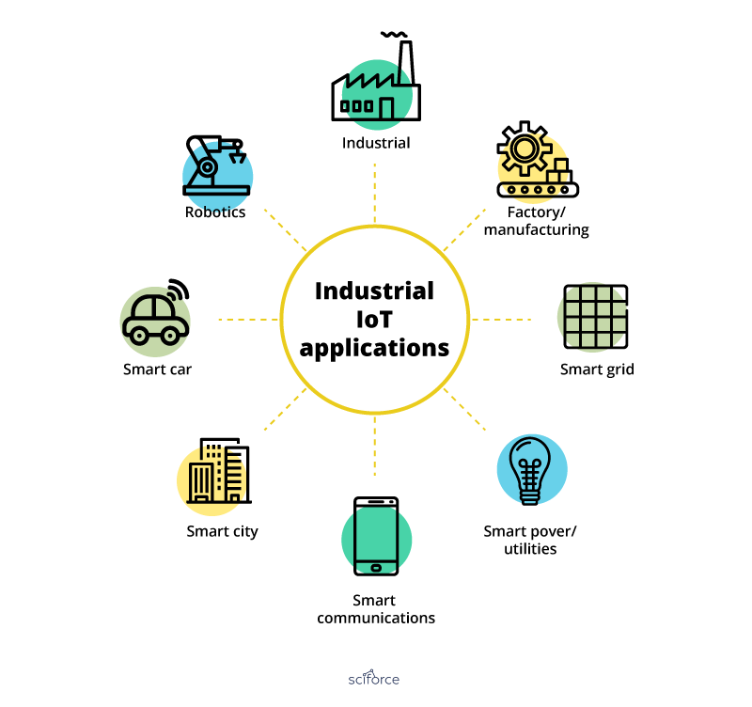

Slide 37
IIoT
The concept behind cloud computing is a computer processor placed at remote location runs a specific application or software rather than running it on each user’s computer. User can interact with the system via a network on the cloud. Most of the times this network is Internet.
Since the storage and processing capacity of the cloud is unlimited, it provides more economic, convenient and secure storage alternatives. The growing storage capacity can also be met as the cloud is expandable.
In connected IIoT, data is expected to flow to and from the connected devices. These streams of data usually get larger with time and that is when Big Data comes in existence. Integration of Big Data into Industrial IoT can help to generate, access and gather the huge amount of data.

Slide 38
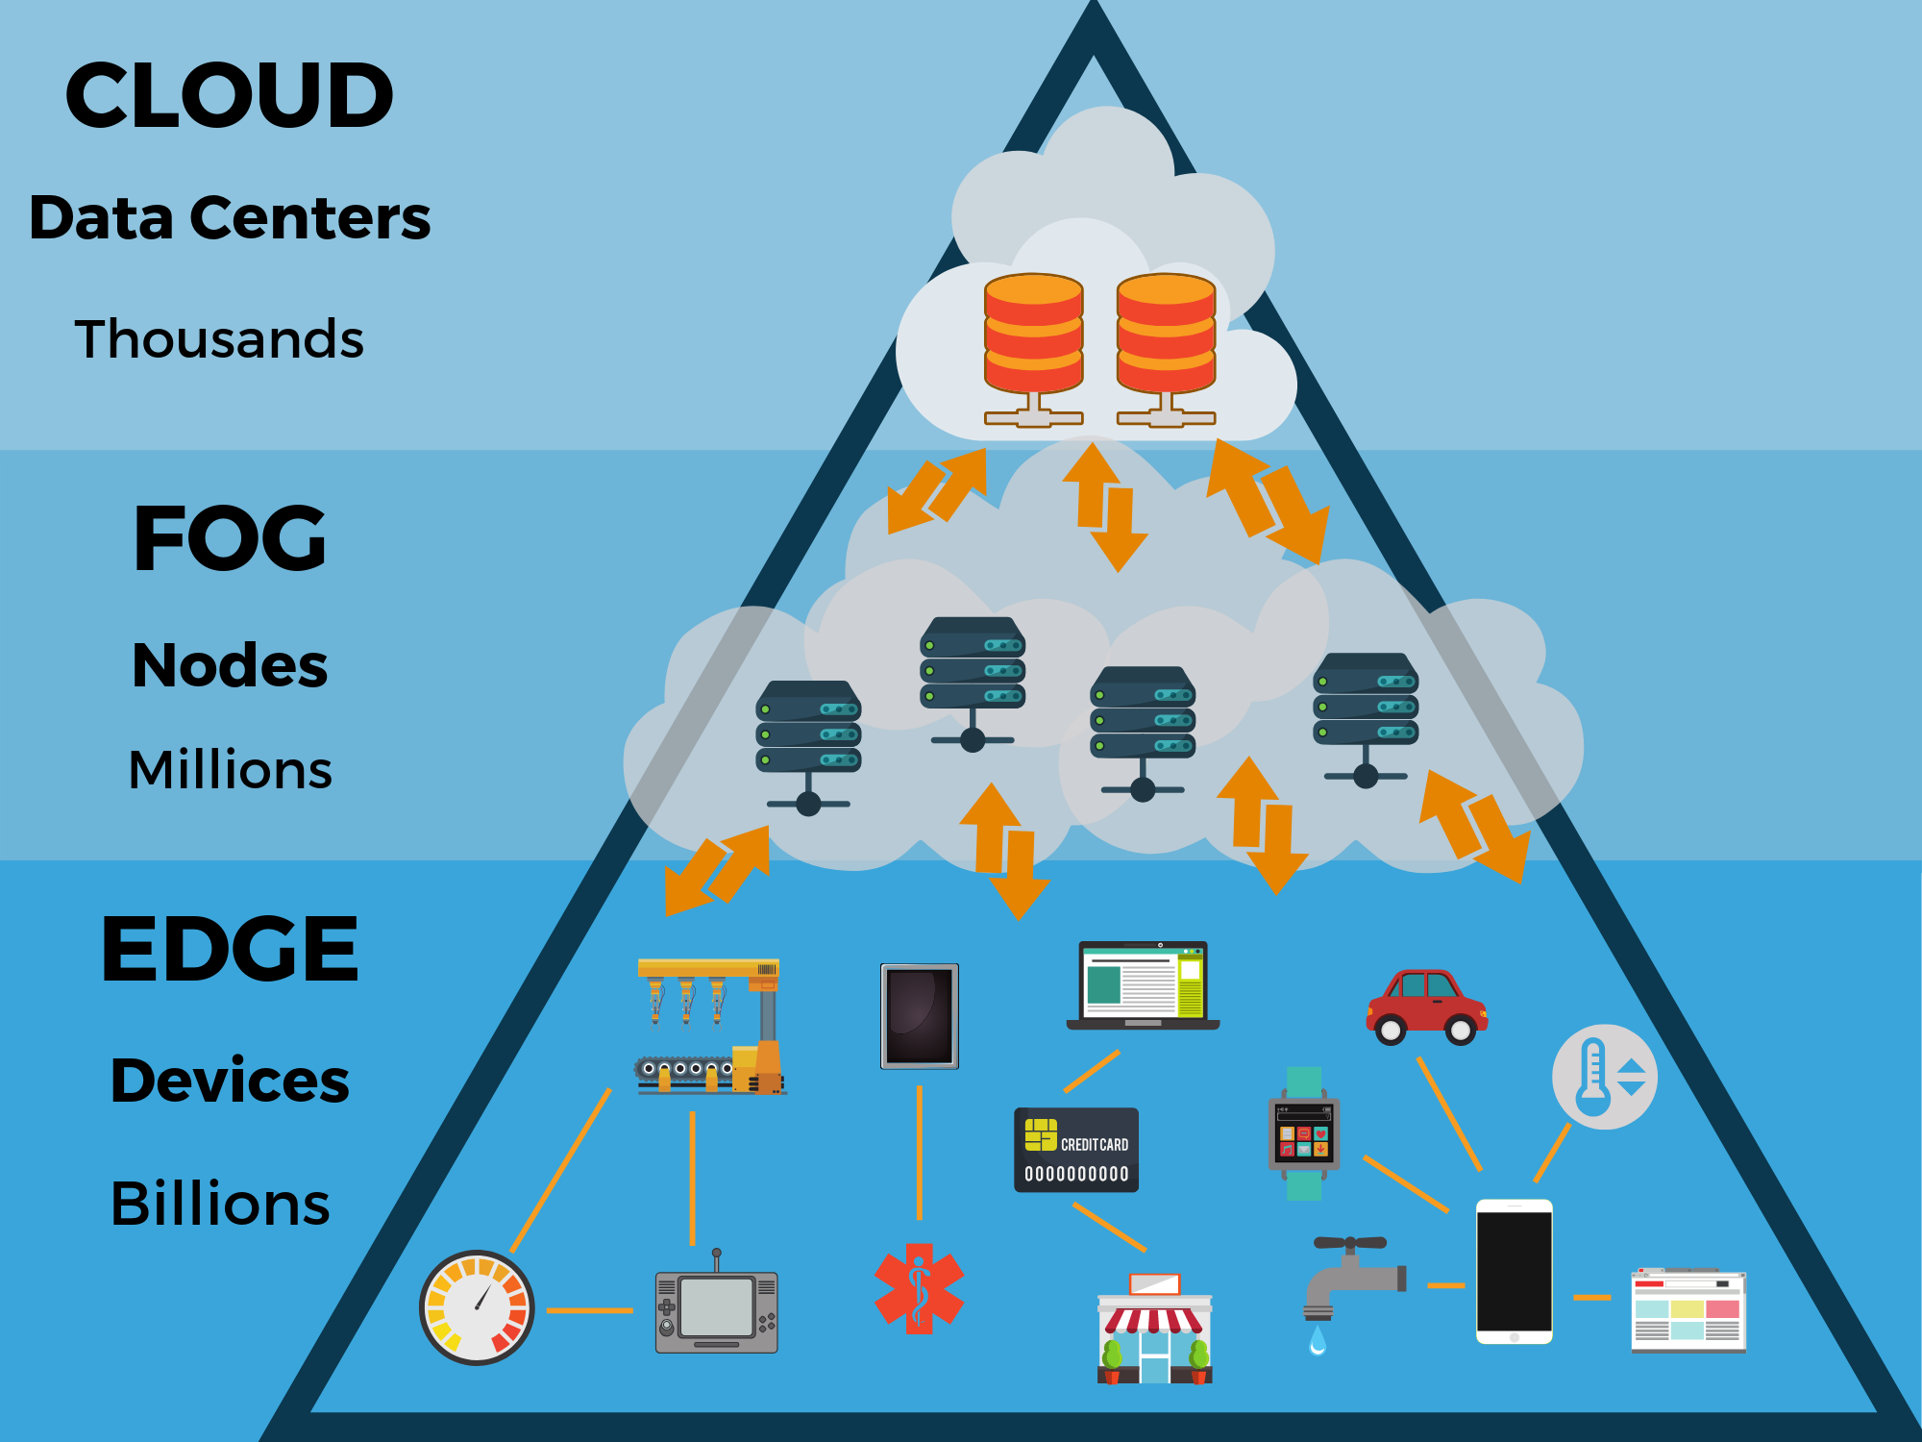
As the Internet of Things evolves, the rise of edge computing becomes inevitable. We need to start thinking how does edge computing fit our digital strategy and start building the implementation roadmap.

Slide 39
Green Cloud Computing
With Green cloud computing, world is looking forward to higher energy efficient mechanism, managed security services, cloud security solutions at one place by offering equivalent and cloud management platform benefits with enormous environmental impact!
Cloud computing, is an important facet for any IT operations of any organization, continuous attempts have been made to make it- much “greener”.
“The green cloud”- certainly a superior marketing label, is employed by organizations for handling environmental considerations and concerns effectively. With contribution, towards the critical business operational goals and reduced costs across the servers, green cloud is most environment friendly initiative.

Slide 40

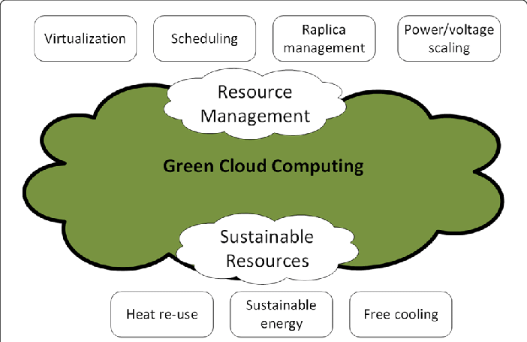

Slide 41
Factors for Green Computing
Product longevity
Gartner maintains that the PC manufacturing process accounts for 70% of the natural resources used in the life cycle of a PC. More recently, Fujitsu released a Life Cycle Assessment (LCA) of a desktop that show that manufacturing and end of life accounts for the majority of this desktop's ecological footprint. Create a product which can support for a longer period of time.
Data center design
Energy efficient data center design should address all of the energy use aspects included in a data center: from the IT equipment to the HVAC (heating, ventilation, and air conditioning) equipment to the actual location, configuration and construction of the building.

Slide 42
Resource allocation
Algorithms can also be used to route data to data centers where electricity is less expensive. Larger server centers are sometimes located where energy and land are inexpensive and readily available. Local availability of renewable energy, climate that allows outside air to be used for cooling, or locating them where the heat they produce may be used for other purposes could be factors in green siting decisions.
Power management
The Advanced Configuration and Power Interface (ACPI), an open industry standard, allows an operating system to directly control the power-saving aspects of its underlying hardware. This allows a system to automatically turn off components such as monitors and hard drives after set periods of inactivity. In addition, a system may hibernate, when most components (including the CPU and the system RAM) are turned off. ACPI is a successor to an earlier Intel-Microsoft standard called Advanced Power Management

Slide 43
Materials recycling
Recycling computing equipment can keep harmful materials such as lead, mercury, and hexavalent chromium out of landfills, and can also replace equipment that otherwise would need to be manufactured, saving further be given for recycling, and they typically sign a non-disclosure agreement.
Algorithmic efficiency
The efficiency of algorithms has an impact on the amount of computer resources required for any given computing function and there are many efficiency trade-offs in writing programs. Algorithm changes, such as switching from a slow (e.g. linear) search algorithm to a fast (e.g. hashed or indexed) search algorithm can reduce resource usage for a given task from substantial to close to zero.

Slide 44
Green Cloud computing practices :
Green cloud computing is the practice of designing, producing, and using digital spaces in a way that reduces its impact on the environment. It aims to minimize the carbon footprint and energy consumption associated with cloud infrastructure and operations.
Examples of green cloud computing practices:
Renewable energy sources: Cloud providers use renewable energy sources to reduce the power needs of data centers.
Optimizing applications: Optimizing applications to run efficiently in the cloud.
Consolidating virtual machines: Consolidating virtual machines into a smaller set of servers.
Improving recycling procedures: Improving procedures for disposal and recycling.
Investing in innovations: Investing in innovations like AWS-designed chips and the AWS Nitro System.

Slide 45
Green Cloud computing practices :
Other examples of green cloud computing practices include:
Optimizing the facility
Optimizing the infrastructure
Optimizing the workflow
Promoting environmentally friendly computer technologies
Implementing sustainable strategies
Promoting eco-friendly practices in data centers
Using energy-efficient computers

Slide 46
Complexity in Cloud Native systems :
Cloud complexity can occur when there is rapid acceleration of cloud migration and net-new development without forethought about the complexity this brings to operations.
The cloud-native ecosystem has a wide variety of tools and platforms, and without common systems, the architecture will inevitably become complex.
Cloud complexity can slow down the development of new applications or services and decrease speed to market. It can also introduce new security threats due to their complexity and vulnerabilities.

Slide 47
5 ways to reduce cloud complexity :
1. Standardize and optimize processes. This will help to minimize errors, achieve more consistent deployments and significantly reduce time to market.
2. Use a cloud management platform and related tools for centralized control and monitoring capabilities across multiple cloud environments. A centralized approach streamlines management tasks, enhances visibility and improves overall operational efficiency.
3. Embrace a cloud-native architecture to leverage the innate tools and services that cloud providers offer. This leads to a focused development process using the capabilities and efficiencies offered by the cloud platform to build scalable and resilient applications as well as optimizing costs.

Slide 48
4. Get expert guidance or partner with a managed service provider to alleviate the complexities associated with cloud deployment and choosing the right cloud provider. Experts can optimize the deployment process, address challenges and ensure the efficient usage of cloud resources, enhancing overall operational performance.
5. Educate and train your teams on best practices, architectural considerations and the implications of security and cost management in the cloud. By ensuring that your workforce is well-informed, you can maximize the benefits of cloud adoption while minimizing risks and potential inefficiencies.

Slide 49
Amazon Web Services :
Amazon Web Services (AWS) is a cloud computing platform that offers scalable, cost-effective solutions. AWS is a subsidiary of Amazon and is the primary profit driver for Amazon.
AWS offers a range of on-demand operations, such as:
Compute power, Content delivery, Database storage, Servers, Networking, Remote computing, Email, Mobile development, Security.
AWS offers a mixture of:
--Infrastructure-as-a-service (IaaS)
--Platform-as-a-service (PaaS)
--Packaged-software-as-a-service (SaaS)

Slide 50
Amazon Web Services :
AWS is available on a metered, pay-as-you-go basis. As of Q2 2021, AWS accounted for about 13% of Amazon's total revenue.
Some companies that use AWS include: Netflix, Twitch, LinkedIn, Facebook.
Useful AWS Applications
--Analytics
--Artificial Intelligence (AI)
--Blockchain
--Internet of Things (IoT)
Amazon Elastic Compute Cloud (Amazon EC2) provides scalable computing capacity in the Amazon Web Services (AWS) cloud. Using Amazon EC2 eliminates your need to invest in hardware up front, so you can develop and deploy applications faster.

Slide 51
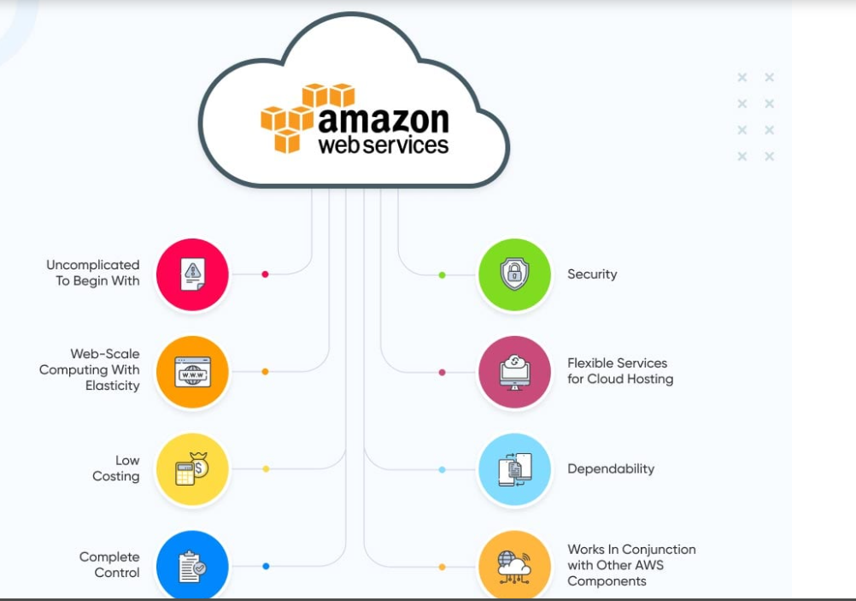
Benefits of Amazon EC2 :

Slide 52
Google App Engine (GAE) :
Google App Engine (GAE) is a cloud computing platform that provides a scalable environment for building and hosting web applications.
GAE is a platform-as-a-service (PaaS) product that gives developers and enterprises access to Google's hosting and tier 1 internet service.
GAE offers a secure execution environment and a collection of services that simplify the development of scalable and high-performance web applications. Applications are sandboxed and run across multiple servers.
GAE applications are easy to create, maintain, and scale as traffic and data storage needs change. Users can upload their application source code.

Slide 53
Google App Engine (GAE) has the following features:
Security scanner: Automatically scans and detects common web application security vulnerabilities
Auto-scaling: Apps can instantly scale automatically based on need, from zero to millions of users.
Managed infrastructure. Google manages the back-end infrastructure for users. This approach makes GAE a serverless platform and simplifies API management.
Support for legacy runtimes. GAE supports legacy runtimes, which are versions of programming languages no longer maintained. Examples include Python 2.7, Java 8 and Go 1.11.
Several programming languages. GAE supports a number of languages, including GO, PHP, Java, Python, NodeJS, .NET and Ruby. It also supports custom runtimes.

Slide 54
API selection: GAE has several built-in APIs, including the following five:
Blobstore for serving large data objects;
GAE Cloud Storage for storing data objects;
Page Speed Service for automatically speeding up webpage load times;
URL Fetch Service to issue HTTP requests and receive responses for efficiency and scaling; and
Memcache for a fully managed in-memory data store.

Slide 55
Google App Engine (GAE) free up to a certain amount of use for the following resources:
--processor (CPU)
--storage
--application programming interface (API) calls
--concurrent requests
Users exceeding the per-day or per-minute rates can pay for more of these resources.
How is GAE used?
GAE is a fully managed, serverless platform that is used to host, build and deploy web applications. Users can create a GAE account, set up a software development kit and write application source code. They can then use GAE to test and deploy the code in the cloud.

Slide 56
Microsoft Azure
Microsoft Azure is a public cloud computing platform that offers a range of cloud services for computing, storing, and networking. It was formerly known as Windows Azure.
Microsoft Azure offers a large collection of services, including:
Platform as a service (PaaS)
Infrastructure as a service (IaaS)
Managed database service capabilities
Microsoft Azure offers access, management, and the development of applications and services through global data centers. It has more than 200 products and cloud services.

Slide 57
Microsoft Azure Services
1. Compute: Includes Virtual Machines, Virtual Machine Scale Sets, Functions for serverless computing, Batch for containerized batch workloads, Service Fabric for microservices and container orchestration, and Cloud Services for building cloud-based apps and APIs.
2.Networking: With Azure, you can use a variety of networking tools, like the Virtual Network, which can connect to on-premise data centers; Load Balancer; Application Gateway; VPN Gateway; Azure DNS for domain hosting, Content Delivery Network, Traffic Manager, ExpressRoute dedicated private network fiber connections

Slide 58
3.Storage: Includes Blob, Queue, File, and Disk Storage, as well as a Data Lake Store, Backup, and Site Recovery, among others.
4.Web + Mobile: Creating Web + Mobile applications is very easy as it includes several services for building and deploying applications.
5.Containers: Azure has a property that includes Container Service, which supports Kubernetes, DC/OS or Docker Swarm, and Container Registry, as well as tools for microservices.
6.Databases: Azure also included several SQL-based databases and related tools.
7.Data + Analytics: Azure has some big data tools like HDInsight for Hadoop Spark, R Server, HBase, and Storm clusters.
8.AI + Cognitive Services: With Azure developing applications with artificial intelligence capabilities, like the Computer Vision API, Face API, Bing Web Search, Video Indexer, and Language Understanding Intelligent.

Slide 59
9.Internet of Things: Includes IoT Hub and IoT Edge services that can be combined with a variety of machine learning, analytics, and communications services.
10.Security + Identity: Includes Security Center, Azure Active Directory, Key Vault, and Multi-Factor Authentication Services.
11.Developer Tools: Includes cloud development services like Visual Studio Team Services, Azure DevTest Labs, HockeyApp mobile app deployment and monitoring, Xamarin cross-platform mobile development, and more.

Slide 60
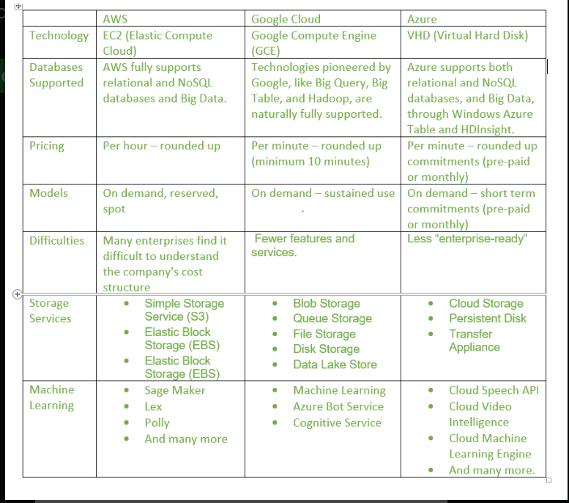
Difference between AWS (Amazon Web Services), Google Cloud, and Azure

